Slide 1
Spatial Clustering and Deconvolution
5/18

Slide 2
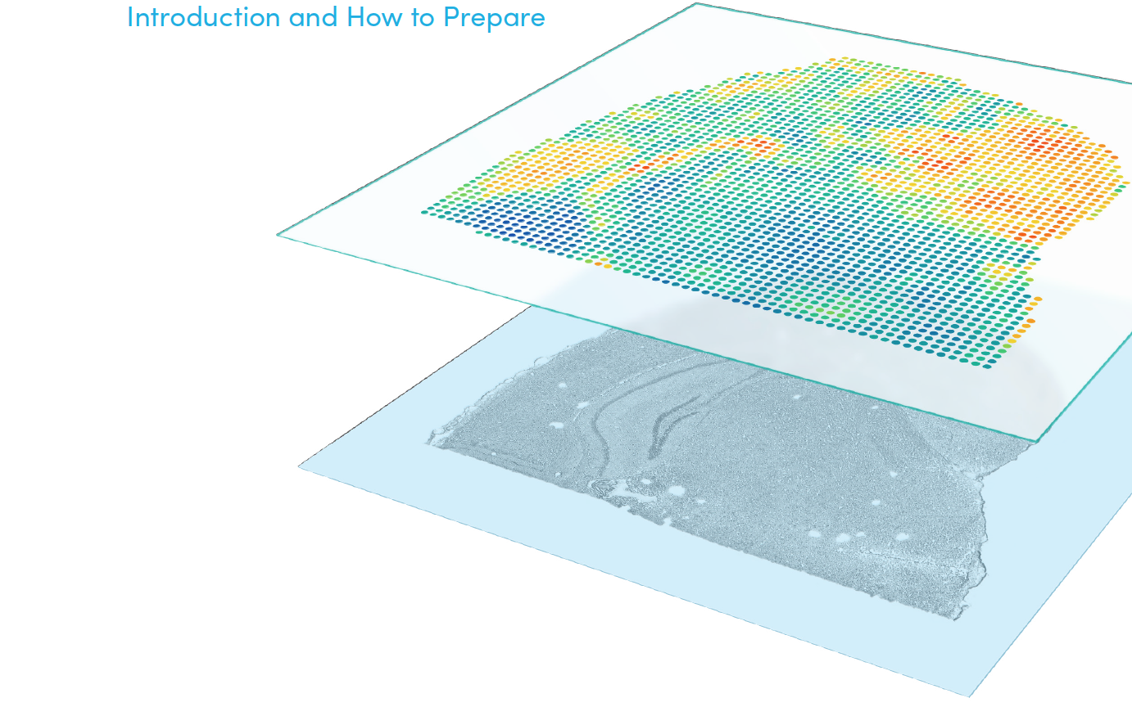
Outline
Visium spatial technology
Spatial clustering
Method
Example: Prefrontal cortex
Spatial deconvolution
Method
Example: Melanoma
Example: Merkel cell carcinoma

Slide 3
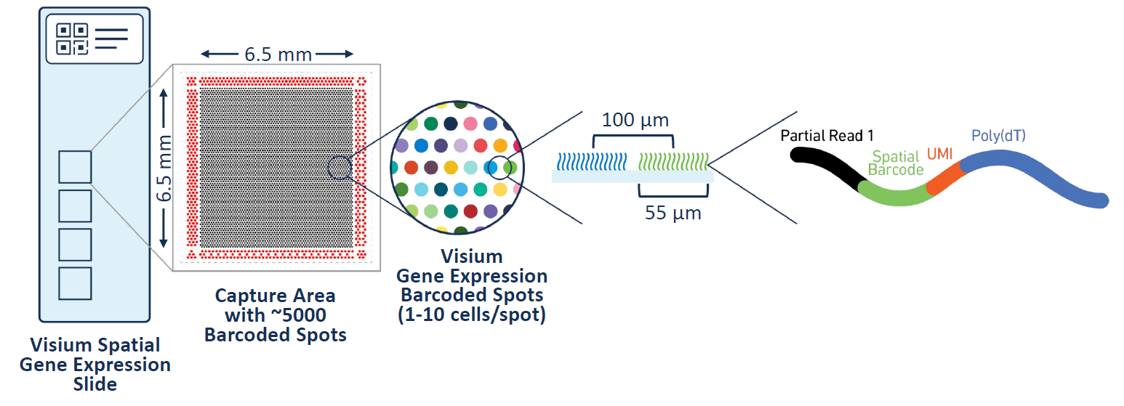
Visium spatial technology
Spatial RNA sequencing provides high-throughput gene expression profiling while preserving the morphological context of the tissue

Slide 4
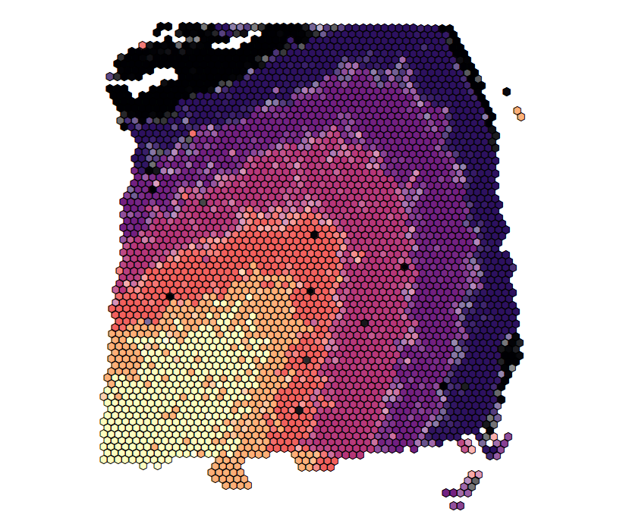
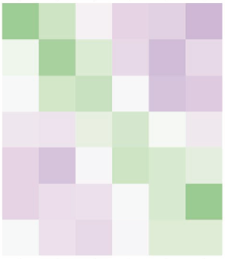
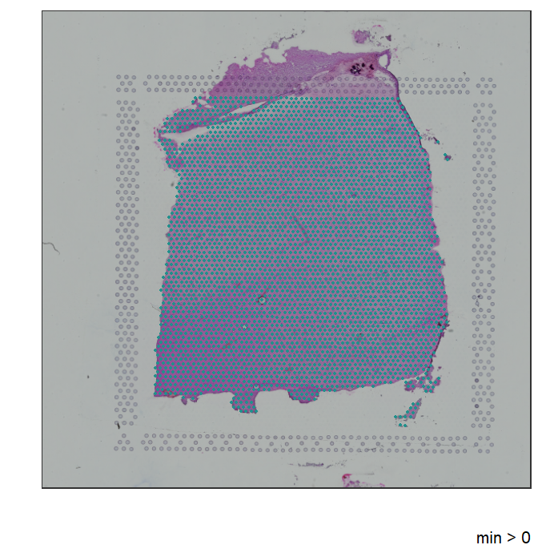
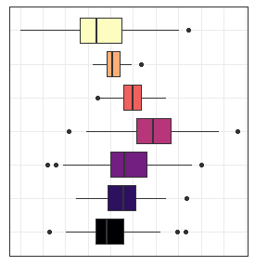
Spatial clustering
Accurate clustering is an important step that allows downstream analyses such as cell type or tissue annotation and differential expression to provide unbiased biological insights
L1
L2
L3
L4
L5
L6
WM

Slide 5
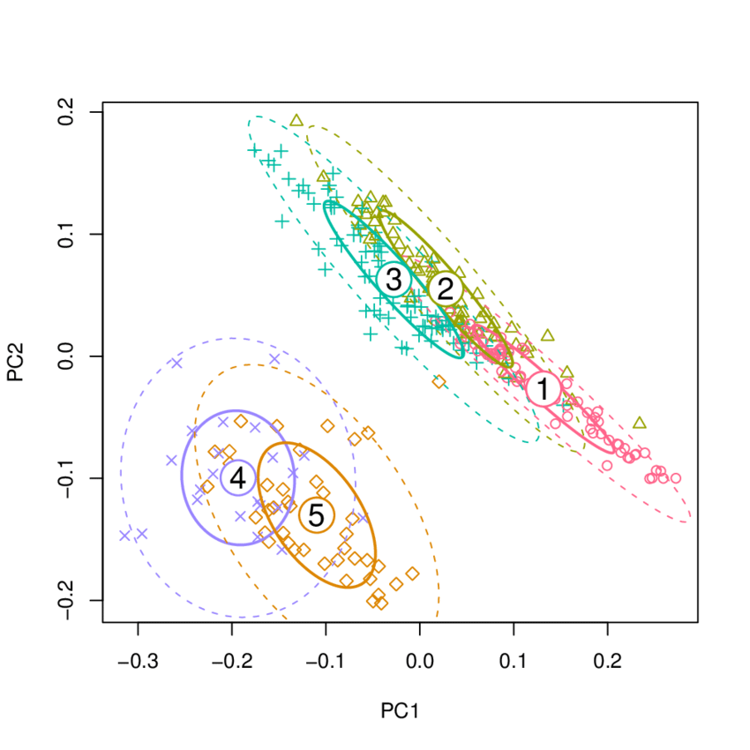
Method
Fit a parametric model to the observed data (principal components)
Using MCMC, iteratively estimate the center of each cluster, variance within clusters, and cluster label of each spot
Spatially smooth cluster labels by encouraging neighboring spots to belong to the same cluster

Slide 6
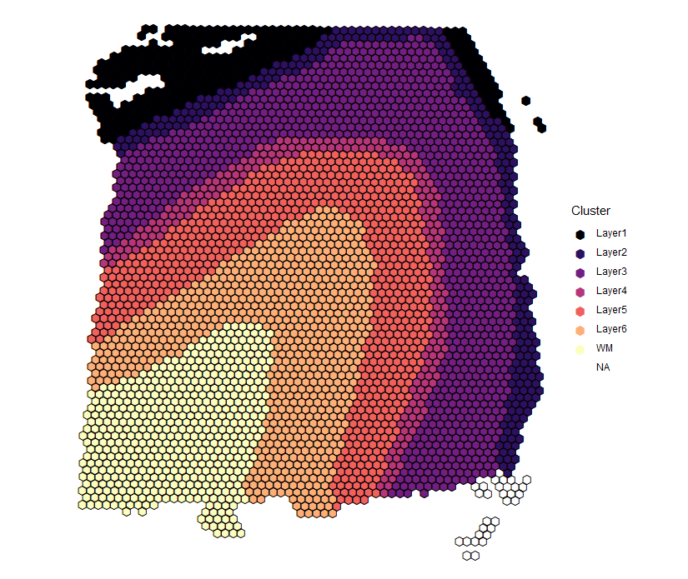
Dorsolateral prefrontal cortex (Maynard et al., 2020)
Manual annotation by expert based on cytoarchitecture and selected marker genes
Considered ground truth
Labor-intensive

Slide 7
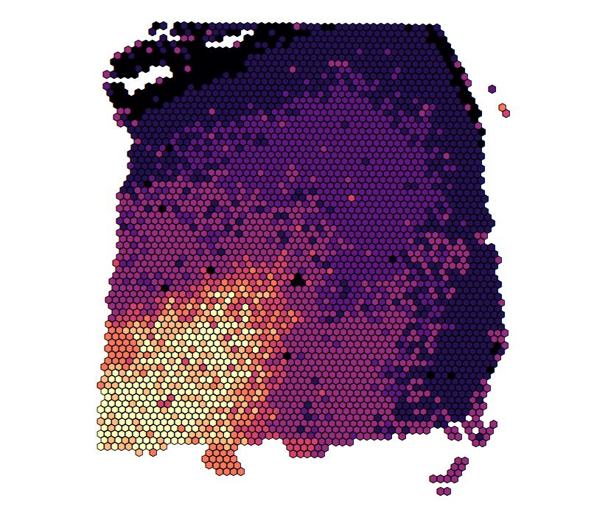
Non-spatial clustering
Shared nearest neighbor clustering on top 50 principal components (PCs) generated from highly variable genes (HVGs) + spatial coordinates
Set to return 8 clusters to improve clustering performance
Adjusted Rand Index (ARI) = 0.27

Slide 8
Spatial clustering
Spatial clustering on top 9 principal components (PCs) generated from highly variable genes (HVGs)
Set to return 7 clusters to match prior knowledge of prefrontal cortex cytoarchitecture
ARI = 0.47

Slide 9
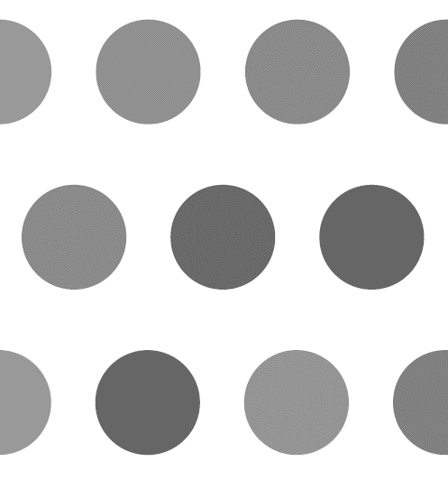
Spatial deconvolution
Visium is not a single cell technology
Deconvolution can:
Increase the resolution of the spatial map
Allow for better understanding of tissues composed of heterogenous mixtures of cells (e.g. tumor microenvironment)

Slide 10
Method
Similar to clustering method, except now the unit of analysis is not a spot but instead a “cell”
Using MCMC, iteratively estimate the center of each cluster, variance within clusters, and cluster label of each “cell” while accounting for the spatial structure
In each iteration, jitter the features of each “cell” while keeping the sum over all “cells” within a spot fixed

Slide 11
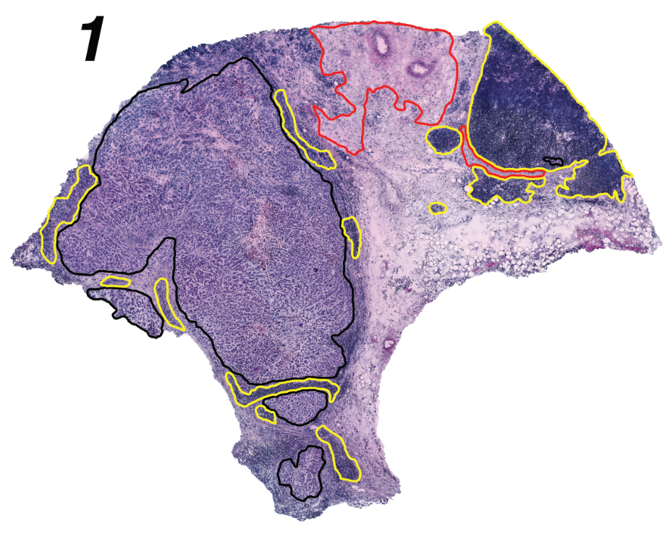
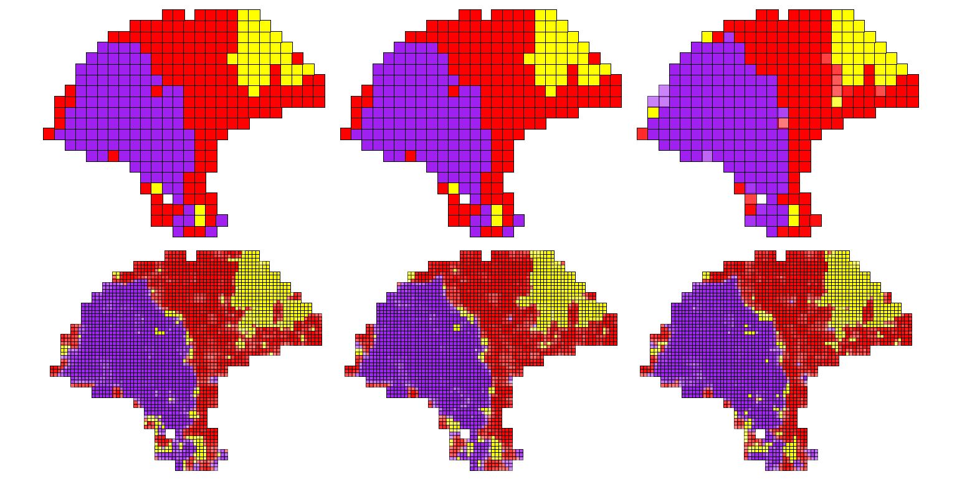
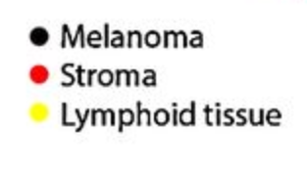
Melanoma (Thrane et al., 2018)

Slide 12
Deconvolution reveals heterogeneity in the tumor immune microenvironment

Slide 13
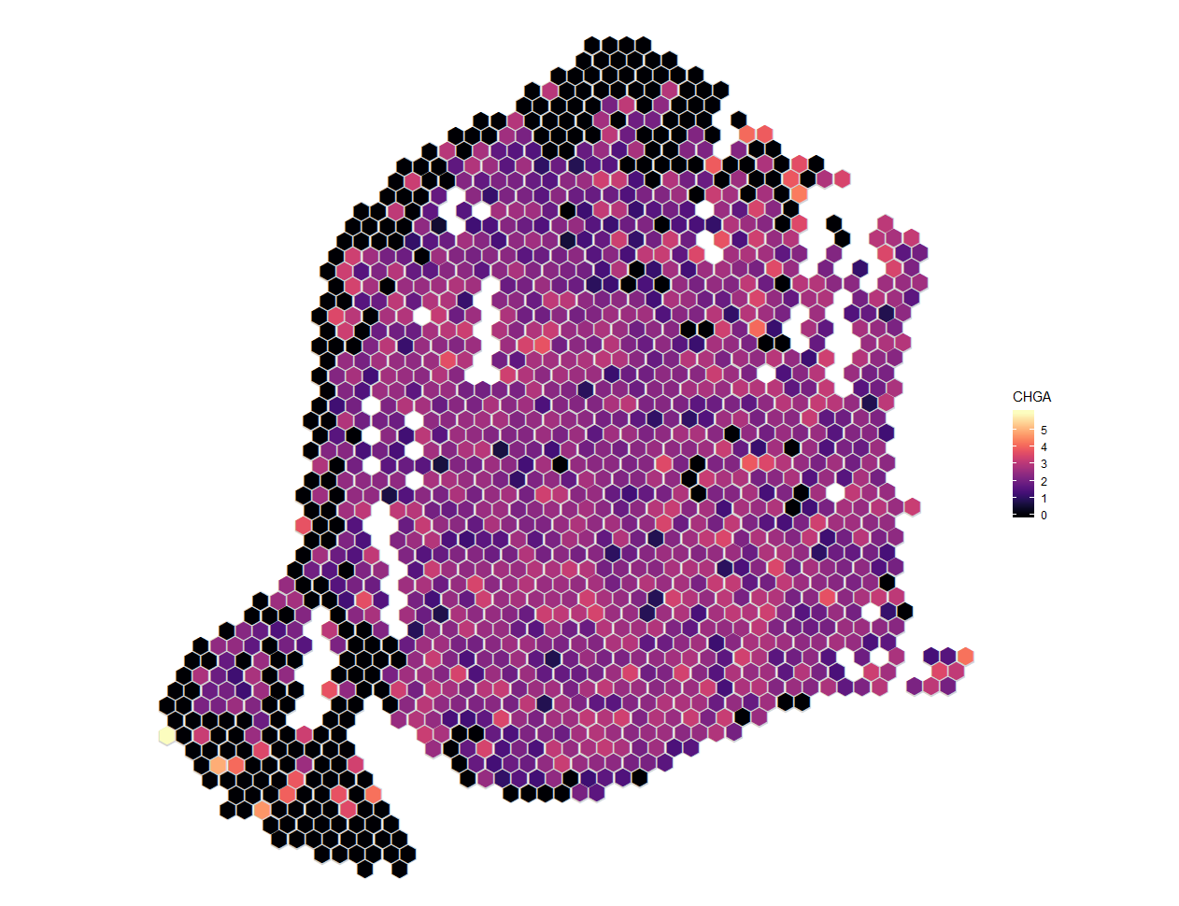
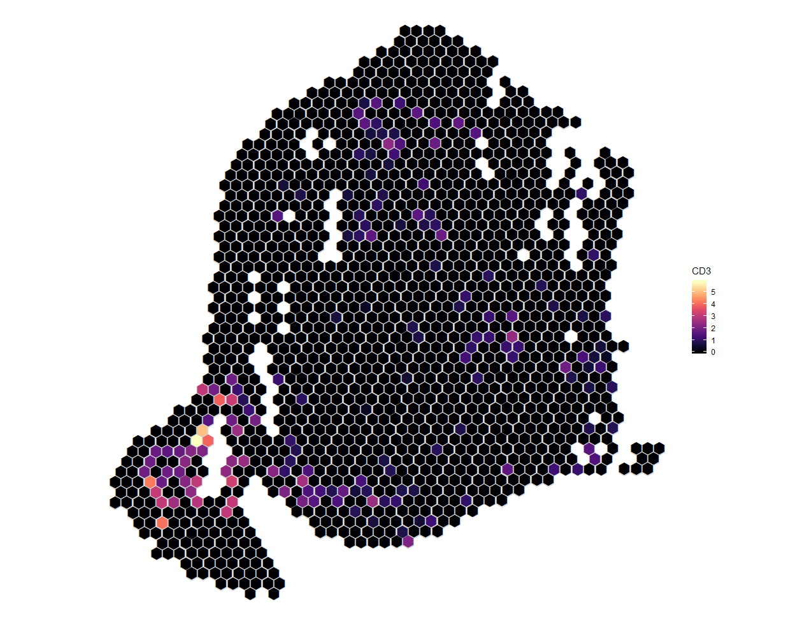
Merkle cell carcinoma (MCC)
CHGA (cancer marker) expression
CD3 (T cell marker) expression

Slide 14
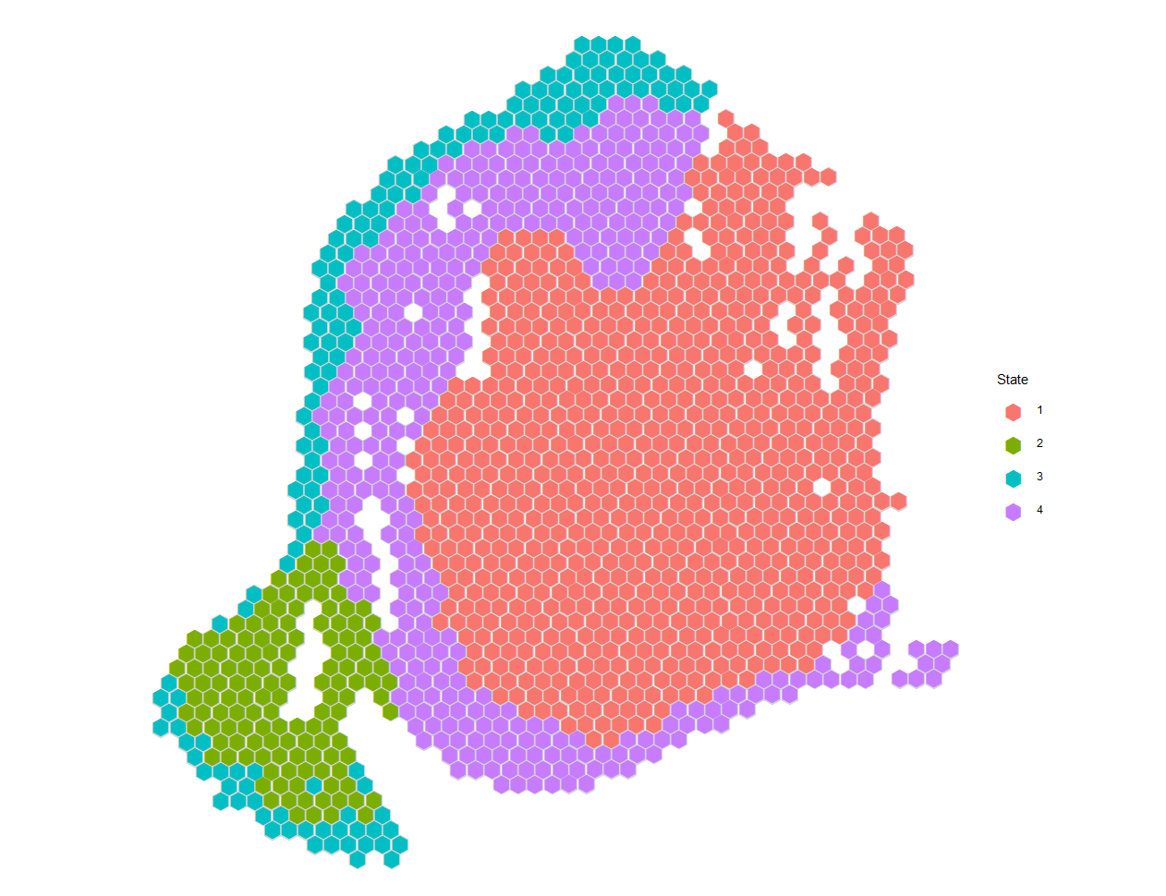
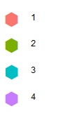
Spatial clustering
Clusters 1 and 4 from spatial clustering correspond to the tumor
Cluster 2 has the highest immune expression

Slide 15
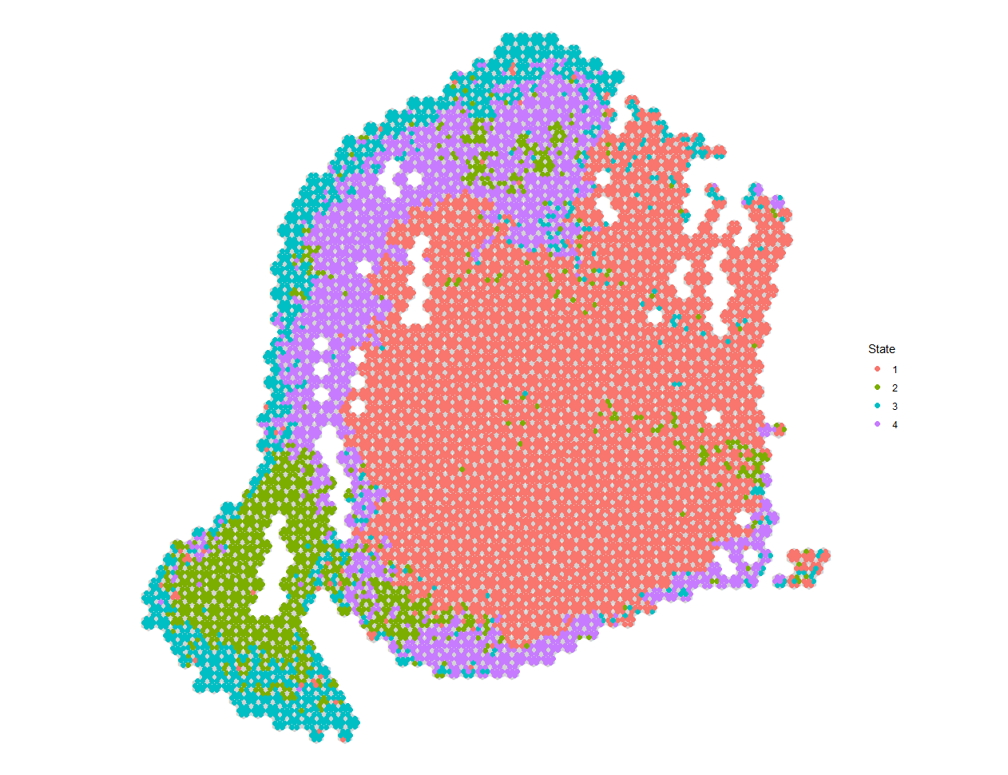
Spatial deconvolution
Most of the immune cells (green) are at the periphery of the tumor
However, there is some evidence of immune infiltration inside the tumor

